Slide 1


EFD-eFunds is now Fidelity National
Information Services (FIS)

Slide 2
Connex OE (IST/Switch)
Overview

Slide 3
Presentation Agenda
Objectives
What is IST/Switch
System Features
System Components

Slide 4
Objectives
To develop an operational knowledge, use of IST/Switch and Features

Slide 5
What is Switch?
A ‘switch’ is a message routing facility between destinations, communicates with many other systems
  Switch is a software that is used to connect Acquiring channels to Financial Institutions, Retailers and Networks
  Processing the transaction, Validating, Logging and Routing

Slide 6
IST/Switch enables..
Electronic Fund Transaction (EFT) processing
Transaction possessing from Automated Teller Machines (ATMs)
Transaction possessing from Point of Sale terminals (POS)
Transaction processing from financial networks and internet banking

Slide 7
IST/Switch with Networks
Supports shared cash networks
    Visa
    MasterCard
    Interac (IMN)
    Amex

Slide 8
Scope of IST/Switch
IST /Switch is a fully functional switch
IST/Switch is a high performance credit and debit processing switch for all transaction processing needs.
Handles unlimited devices, Networks and host systems
Authorizes on behalf of Financial Institutions
Processes at a high rate of transactions per second (TPS)
Multiple security checks and cryptography
Multiple currency supports
Superior logging, tracking and reporting services

Slide 9
Features of IST/Switch
Multiple Institution Support
The release of IST/Switch 7.4 embraces the concept of an institution as the highest level entity within the exiting BIN hierarchy
The processor, as opposed to the acquiring or issuing institution itself, is now processing on behalf of many institutions
This properly identifies the different institutions and establishes the relationships between them within the single IST/Switch instance

Slide 10
Features of IST/Switch
Transaction Routing
In the multi-institution IST/Switch, routing model supported:
Issuer-based Priority Routing:-
  Ability to set priority of issuers for routing.
  This can be based on dual-branding of cards or the Issuer being down.
  This will be supported through the Issuer Profile table and Extended BIN table.

Slide 11
Features of IST/Switch
POS Subsystem Enhancement
Hypercom and Visa 2nd Terminals
This new version implements an acquiring entity hierarchy for all institutions to facilitate wide range of on-line processing
This version enhanced to process TC57 formatted capture file for clearing purpose

Slide 12
Features of IST/Switch
JAVA GUI Framework
IST/Switch configuration tables are populated using the Java-based IST/Switch GUI. The interface can be used for a multi-institution or a single-institution installation of IST/Switch.
The framework is tightly coupled with the Oasis Authentication and Entitlement services, which offers secure managed access automatically to all GUI forms.

Slide 13
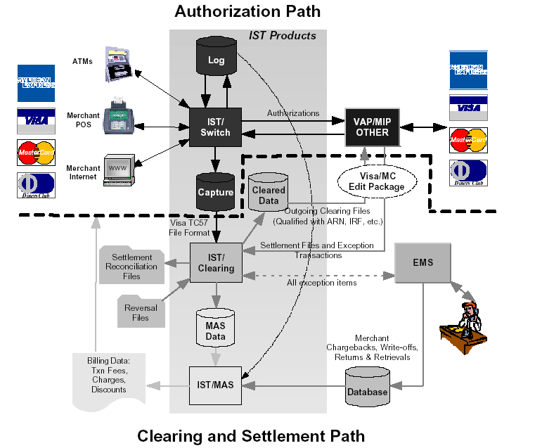
IST/Switch and the Oasis Product Scope

Slide 14





IST/Switch Architecture
ATM / POS Network
Internet
Financial Network
Switch
. . .
Clearing
MAS
iB
ISO EFT Switch
POS
Foundation
ATM
Routing
Logging
Advice
Message Mgmt
Datatypes
GUI
Containers
Mailbox
Operating System

Slide 15
Mailbox Manager
Provides fundamental Inter-process communication service to Application
Its architecture provides the IPC mechanism to Application
Mailbox Manager is responsible for creating, deleting, and locating a mailbox

Slide 16
Task Manager
A Task is an executing instance of an IST/Foundation Application or Module
Task Manager initializes and monitors Foundation tasks(processes) and also ensures proper execution of the same.
Task Manger will re-initialize when the task is getting terminated.

Slide 17
Port Manager
Port Manger starts and monitors tasks associated with message port.
A message port is a special kind of Mailbox associated with communication driver.
The Port Manager is primarily responsible for establishing,maintaining,monitoring and shutting down the connections between tasks

Slide 18
Event Manager
Event Manager is a daemon that handles timer events for the Applications request
Event Manger Monitors timer and notifies the requesting application
Events are stored in an event queue and monitored by the Event Manager

Slide 19
Database Manager
DBM is flexible enough to interface with a number of RDBMS such as
  Oracle,Informix,Sybase and DB2
Provides a set of interchangeable shared libraries,each implementing the standard DBM API for a particular DBMS.
Provides Low level layer between the application code and the native client library code

Slide 20
Thank You!

